Slide 1

Go and backend development
Notes:
do we really need another programming language??

Slide 2



Notes:
- we’ll obviously start golang presentation with… c++ example. Then with js. And then we’ll switch to golang...
- a little theory, lots of examples

Slide 3


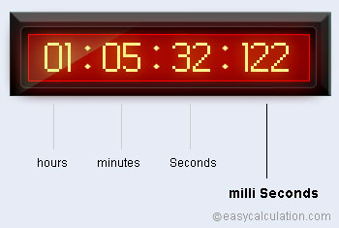
Notes:
embedded - milliseconds
web dev - hundreds of ms, seconds, even infinity
software release cycle
different approach to programming
performance/defensive vs scalable/simple code
various approaches and thus languages and, eg. to sending a http request

Slide 4
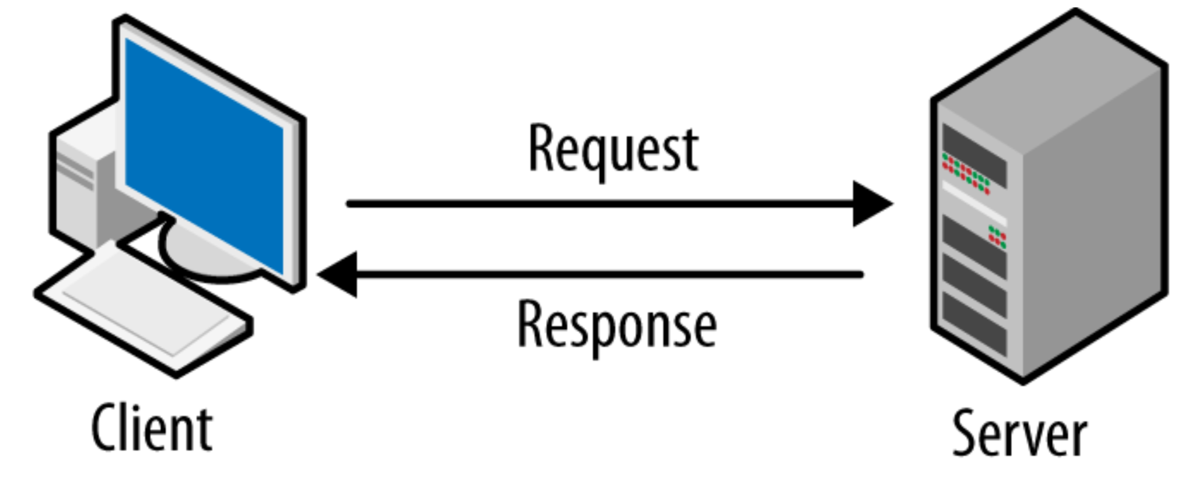
Notes:
I won’t bore you with go lang syntax and semantics
we’ll dive directly into an interesting example
based on client-server arch. Server will be serving responses sequentially and we’ll examine various client approaches

Slide 5
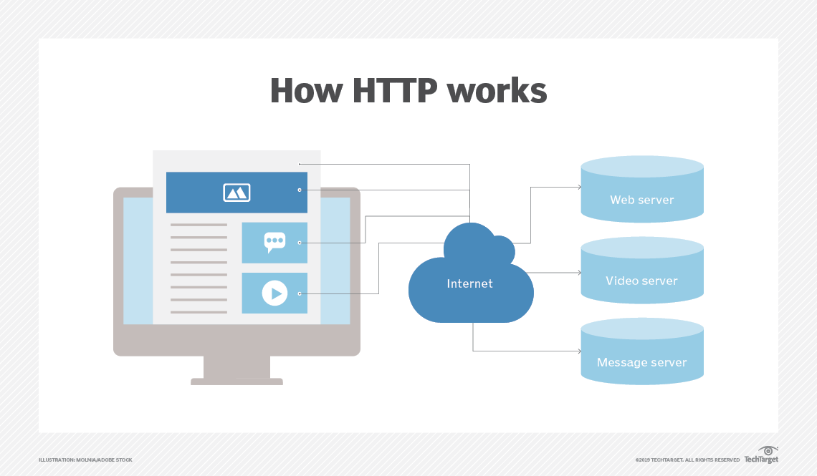
response:
Hello world 1
Hello world 2
….
Notes:
let’s focus on http protocol
GET
response Hello world with counter

Slide 6
Examples

Slide 7
Server
nodejs server
Notes:
implemented locally to show deterministic results
response delay specified

Slide 8
Clients
single threaded C++
asynchronous Js
multi threaded C++
single threaded Go
multi threaded Go
Notes:
c++ boost lib, there’re other.
lot’s of code, difficult but great control and performance
limited no of threads
async - great alternative
event loop, callbacks, await is a syntactic sugar only
go - lifted multithreading

Slide 9
Summary
 | C++ | Js | Go
 | single threaded sync | single threaded async | single threaded sync
 | multi threaded sync |  | multi threaded sync
4000 requests get time | 2.2 s | 3 s | 2.4 s
Notes:
4000 requests get time just as a general remark, not optimized

Slide 10
C++ vs Go multithreading
[cpp, go]_multithreaded_calc.go

Slide 11
Threads
OS process
The smallest unit of execution that CPU accepts
There can be many threads within a process
Each process has at least 1 thread
Threads can run in parallel or concurrently
Threads share the same address space
Fixed stack size (eg. 8MB on ubuntu)
Thread context switching is expensive - process context and thread context is copied
Heap
Data
Code
OS Thread 1
OS Thread 2
Stack
Stack
Registers
Registers
PC
PC
Notes:
there are processes in OS
they’re instances of a running program
OS scheduler makes scheduling decisions at thread level, not process level

Slide 12
Threads
OS process
Sharing memory between threads creates complexity and can lead to data races
Critical section guards are a developer convention, no tool to enforce that
Heap
exclusive access
OS Thread 1
OS Thread 2
Stack
Stack
Registers
Registers
PC
PC

Slide 13
Goroutines
OS process
Heap
We can think of goroutines as user space threads, managed by go runtime (built into executable)
goroutines run in the context of a single OS thread - from OS perspective nothing has changed
lightweight - 2KB of stack
low CPU overhead - three instructions per function call
sharing of memory is avoided with usage of channels
Data
Code
OS Thread
………...
Goroutine 1
stack
Goroutine N
stack
Notes:
can create hundreds of thousands of goroutines
context switching between goroutines is much cheaper than threads bc there's less state to be stores
it’s great bc for http request mst of the time is waiting

Slide 14
Communicating Sequential Processes
paper by Tony Hoare (1978)
based on 3 simple ideas:
each process is build for sequential execution - every process has a local state and it operates on it
no shared memory - data is communicated between processes - no race conditions or deadlocks
scale by adding more of the same

Slide 15
Go lang overview
Go was developed by Google to replace the in-house use of Python, C/C++, Java and other system languages.
First released in 2009, written in C, C alike syntax,
Go is open-source and has a rich community that actively participates in its development.
The language core is updated every six months while keeping the programming interface stable.
Compiled
Statically typed
procedural/functional paradigm

Slide 16
Go lang overview
go_overview.go
go_overview_test.go
go_multithreaded[2,3,4].go
Notes:
oop
procedural
functional
class-based
prototype-based

Slide 17
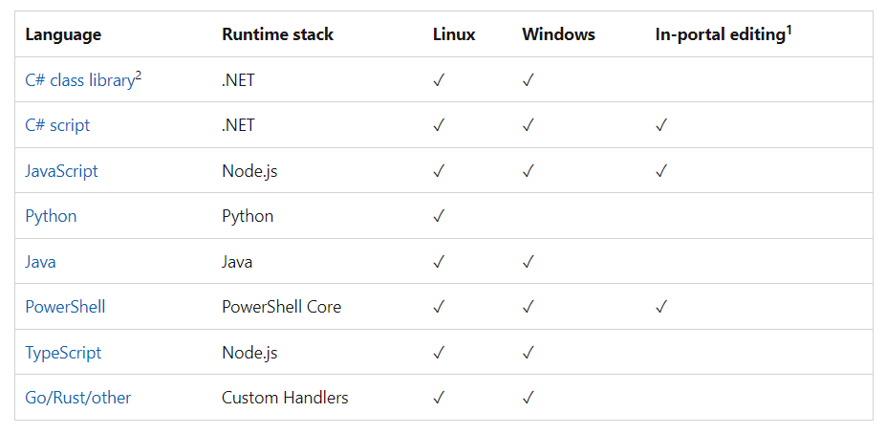
Cloud development
azure functions serverless example
https://docs.microsoft.com/en-us/azure/azure-functions/supported-languages
Notes:
not the whole picture, bc can run in containers

Slide 18
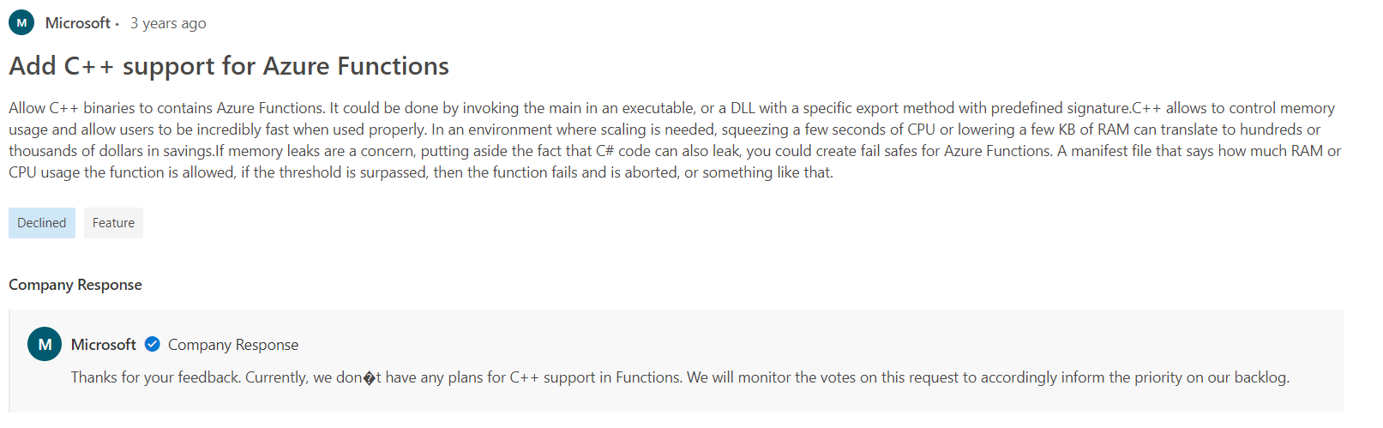
How about c++?
https://feedback.azure.com/d365community/idea/84989e2f-f224-ec11-b6e6-000d3a4f0da0

Slide 19
Summary
 | C++ | js/nodejs | go
versatile
performance
faster compile time |  | —
easy to learn/use
community
 | OOP class based | OOP prototype based | post OOP
 | compiled | interpreted | compiled
 | statically typed | dynamically typed | statically typed
Notes:
c++ the most versatile but many external libs may be needed, def usage - max performance, quick response time. You can do anything in this language but it has its cost - often it’s complicated and takes a lot of effort - great power comes with great responsibility. There are even async mechanisms in boost::asio (multithreaded async) and even boost::fibers - user-space level threads.
js/nodejs - versatile too but in different areas - both to frontend and backend. Single threaded and async approach takes time to getting used to. Good performance, but it’s interpreted language
go - mainly for backend development (governing scalable servers network), just a step behind C++ with performance, very low learning curve and not demanding memory management

Slide 20
Go learning resources
https://gobyexample.com/
https://go.dev/doc/tutorial/
https://motorolasolutions.udemy.com/course/concurrency-in-go-golang/
Notes:
show the first one?

Slide 21
Thank you!
https://github.com/bondyr/backendDevPpt
Notes:
show the first one?

